Slide 1
ASEM – FGI Label Verification
Prepared by Chong Kim Chor (ASEM-IT)

Slide 2
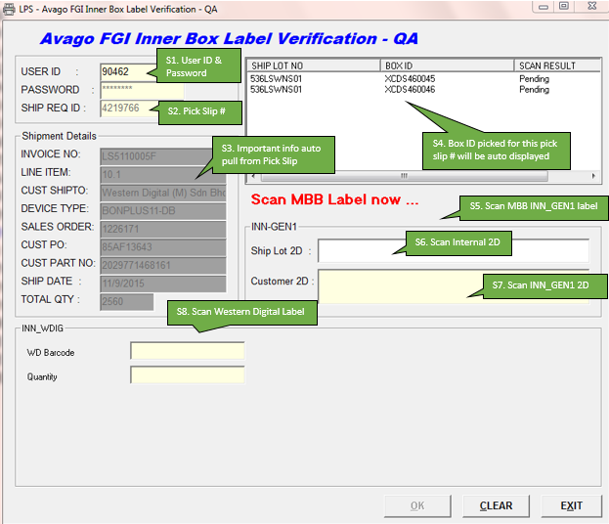
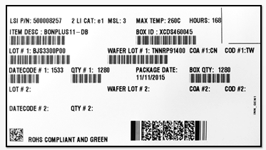
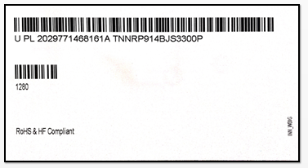
FGI Label Verification System – Western Digital … 1
INN_GEN1 Label
INN_WDIG Label

Slide 3
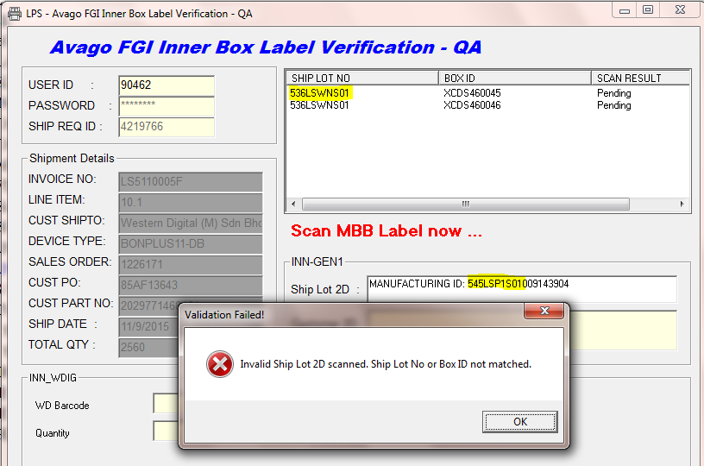
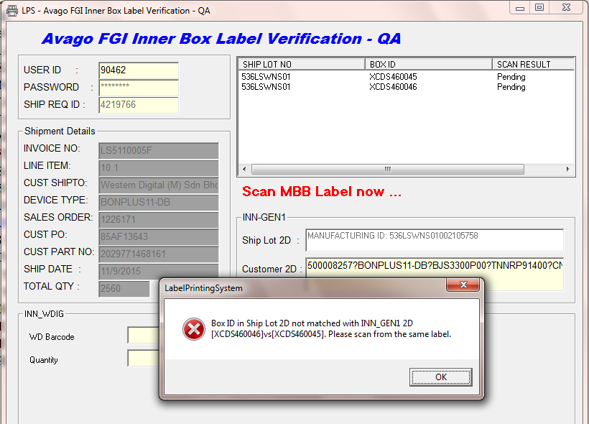
FGI Label Verification System – Western Digital … 2
1
Pic 1:
If the Ship Lot 2D scanned is not belongs to any Box ID listed, system will prompt error.
User have to scan again the correct label.
2
Pic 2:
If the INN_GEN1 2D scanned is not matched with Internal ship lot 2D, system will prompt error.
User have to scan Internal Ship Lot 2D and INN_GEN1 2D from the same label.

Slide 4
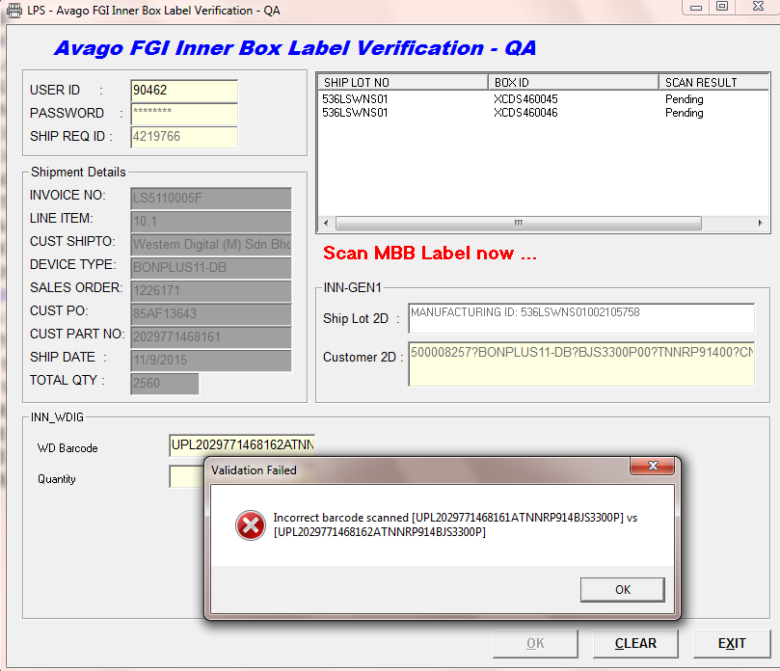
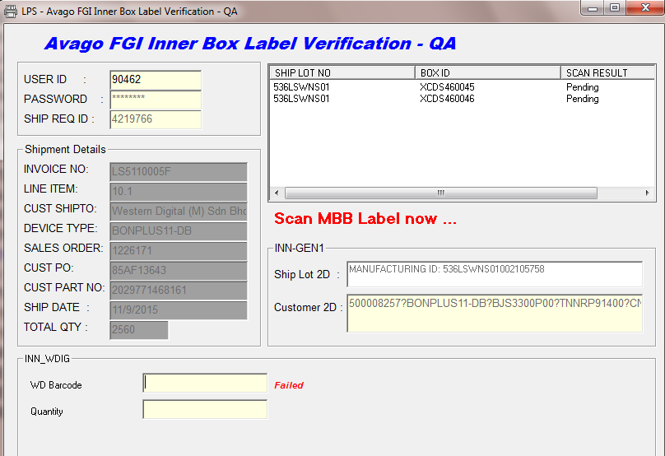
FGI Label Verification System – Western Digital … 3
1
Pic 1:
Next to scan Customer Label. If the barcode scan not matched with system, error will be prompted and scan result is failed (Pic 2)
User cannot proceed until the correct barcode is scanned.
2

Slide 5
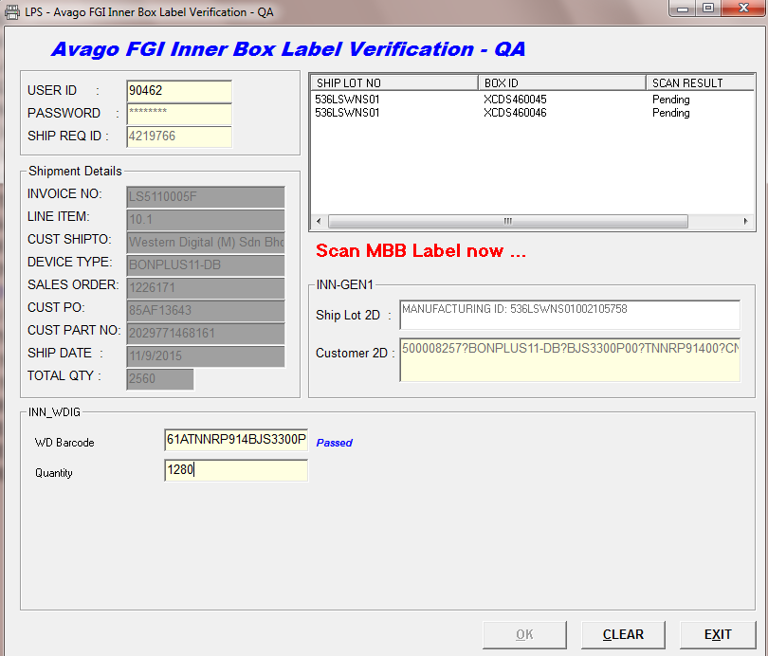
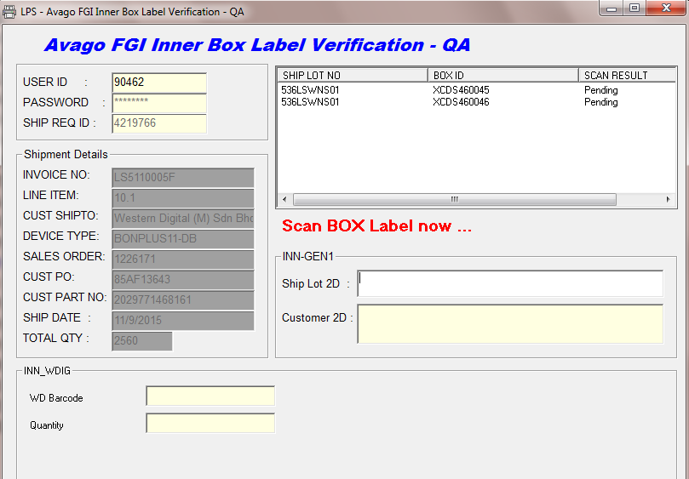
FGI Label Verification System – Western Digital … 4
1
Pic 1:
Until the scan result is Passed, next is to scan the quantity from customer label.
Pic 2:
If the quantity scanned is passed, MBB label scan is completed. Next is to scan the BOX label.
2

Slide 6
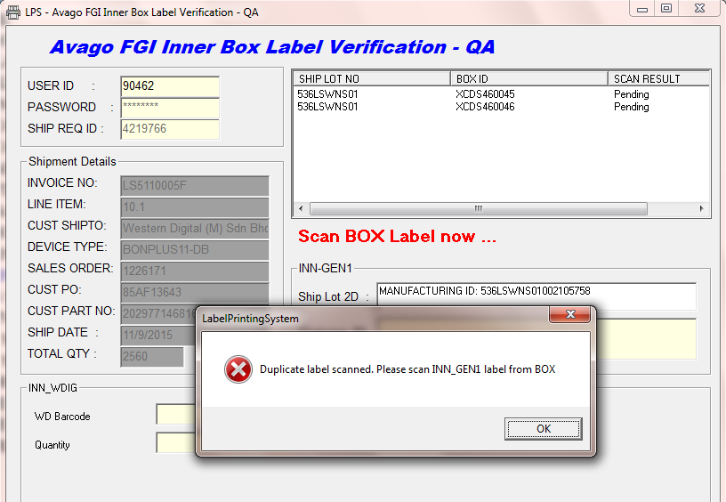
FGI Label Verification System – Western Digital … 5
Every INN_GEN1 label has the unique internal ship lot 2D and it is tagged to the Box ID. System will only accept the correct unique ship lot 2D vs box id.
To avoid user scan the same label twice, system will detect if the same internal ship lot 2D scanned. The same label cannot scan more than 1 time.

Slide 7
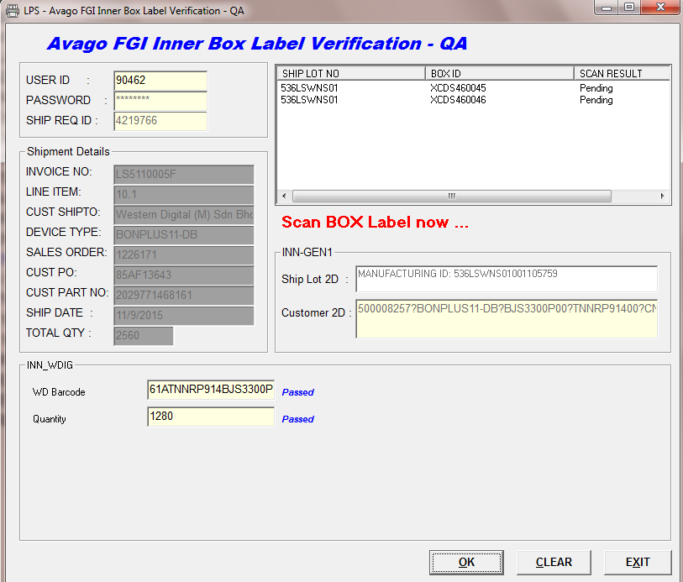
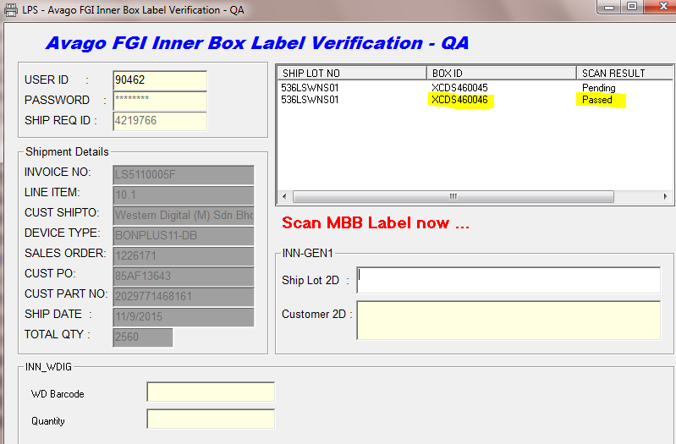
FGI Label Verification System – Western Digital … 6
1
Pic 2:
Once the [OK] button is clicked, the scan result for the box will changed to Passed.
User can continue to scan MBB label for next box.
2
Pic 1:
Once completed scanned MBB, BOX label the result is passed, the [OK] button is enable. Click the OK button to complete the scanning for 1 box.

Slide 8
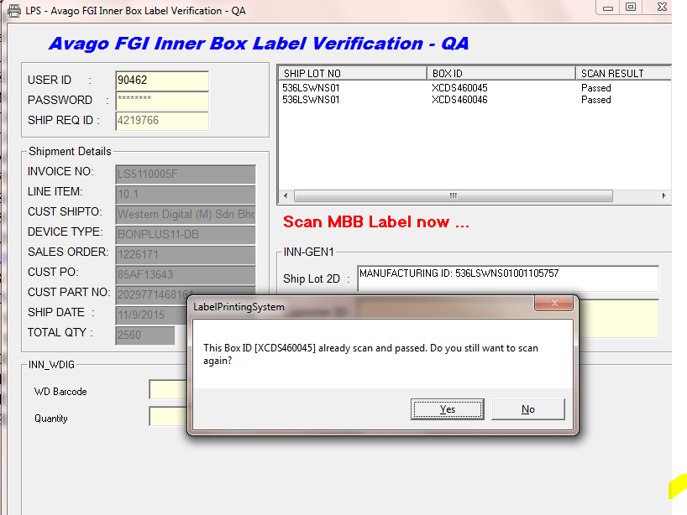
FGI Label Verification System – Western Digital … 7
If the Box ID already scanned before and scan result passed, system will prompt message box and user can select Yes to scan again and No to stop the scanning.

Slide 9
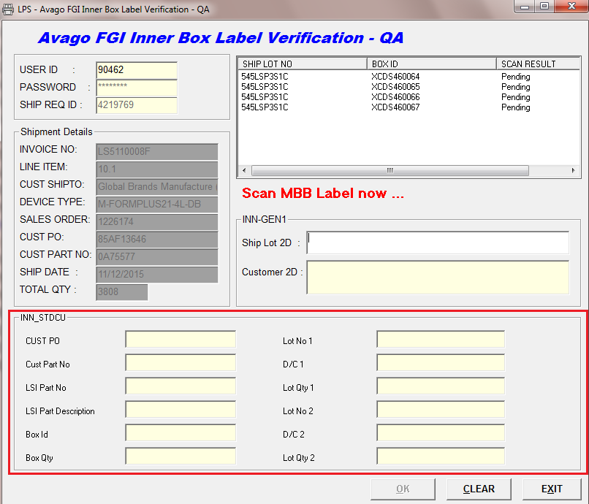
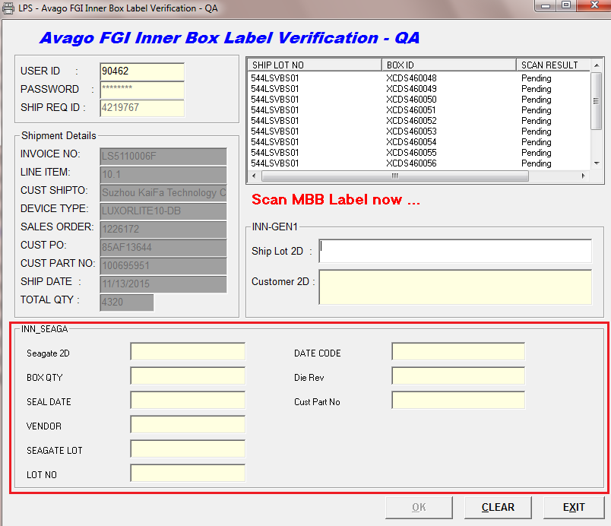
FGI Label Verification System – Others Customer’s Label
Scanning logic for other customer’s label is the same, just that the field required to scan is different based on every customer label designed.

